Slide 1


Education Sector Meeting
4 March 2020

Slide 2
Agenda
12:30 Arrival – tea and coffee available
13:00 Meeting starts
Labour Market trends - Josh Prentice, Communications and Research Officer, REC
Update on CCS Framework – John Wilson, Category Lead, CCS
14:10 Coffee Break
Update on REC Audited and KCSIE consultation– Chris Russell, Policy Adviser, REC
Update on legal changes coming in April – Jane O’Shea, Solicitor, REC and Bunmi Adefuye, Senior Solicitor, REC
16:00 Close
What happens now?

Slide 3
REC’s education executive
There’s an opening to become a member on REC’s Education Executive Committee.
As a member of this committee, you are expected to:
Attend three meetings a year
Feed into REC policy and sector group discussions
Feed into setting the agenda for future sector meetings
Applications will only be accepted from individuals who are employed by a REC corporate member that operates in the education sector. Membership of the committee is attached to the individual rather than the REC member.
Please note that this is a purely voluntary position. No salary is available and there is no reimbursement for time allocated to REC duties.
To apply, please send a statement of up to 300 words to chris.russell@rec.uk.com before 5.30pm on 9 April. This statement should include why you want to be part of REC’s education executive and what you would add to the group.
Successful applicants will be interviewed by the Chair and Vice Chair of the sector group as well as a member of REC staff.

Slide 4
Wi-Fi and sli.do
sli.do: Q&A and polling platform
No app installation required
No log-in required
Go to www.sli.do on your device
Enter event code: #REC
Enter any questions as the event progresses
Audience polls will be used
Can be used if live-streaming
Wi-Fi
Network: RECGuest
Password: AccessGuest21

Slide 5
Jobs market data
The latest REC research

Slide 6
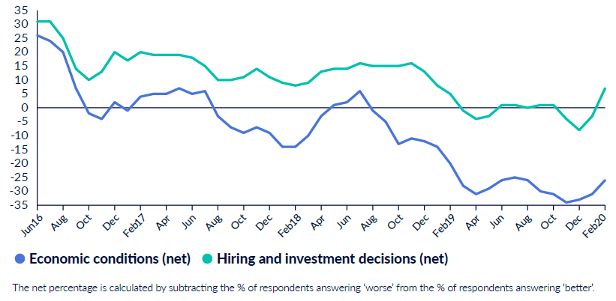
Employer confidence in hiring returns to positive territory
According to our latest monthly survey of employers (JobsOutlook):
Employers’ confidence in the UK economy has improved since the December election, although it remains low overall at net: -26.
Businesses have also become more confident about their ability to make hiring decisions. Confidence levels are now positive overall, at net: +7.

Slide 7
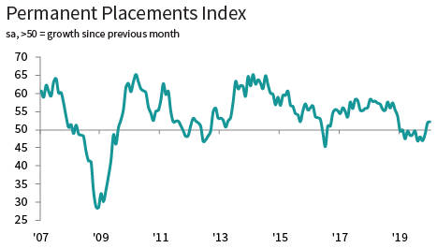
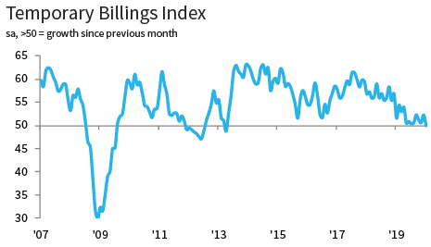
Permanent staff appointments increase following election
According to our monthly survey of recruiters (Report on Jobs):
Permanent placements increased in December 2019 and January 2020, following almost a year of decline. Recruiters said that some clients had decided to approve new hires following a long period of delayed decision-making.
Temporary billings fell slightly in January 2020, the first fall since 2013. This was linked to the upcomingIR35 changes, and higher demand for permanent workers at the beginning of the year.
Permanent staff appointments rose at end of 2019

Slide 8
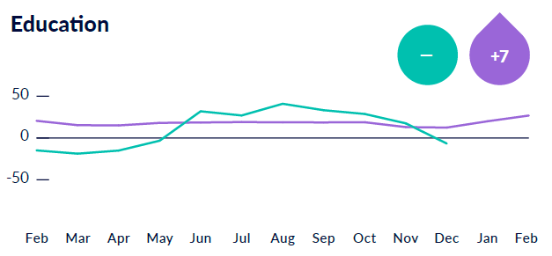
Demand for staff is high, and employers are worried about shortages
According to our latest monthly survey of employers (JobsOutlook):
Short-term demand for permanent staff in education remains high, at net: +27.
Education is also one of the top sectors where employers are worried about skills shortages, with one in four employers worried about a shortage of candidates for permanent roles.
However, demand for temporary agency workers in education has been falling over the past few months.

Slide 9
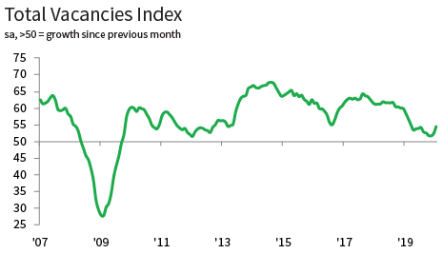
Vacancies growing at a quicker pace
According to our monthly survey of recruiters (Report on Jobs), demand for staff grew at its quickest rate for 10 months in January, mainly driven by growth in permanent vacancies.
A recent Education Policy Institute report found 20% of schools in less disadvantaged areas had vacancies or temporarily filled posts, compared with 30% in the most disadvantaged areas.
Problems are most acute in shortage subjects such as maths, science and languages.

Slide 10
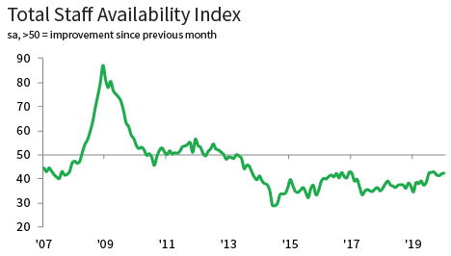
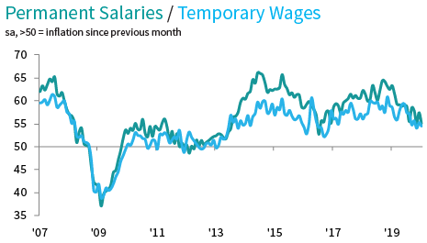
Falling staff availability continues to push up wages
According to our monthly survey of recruiters (Report on Jobs):
Staff availability has been dropping since May 2013, and that trend is continuing.
Recruiters linked this to lingering uncertainty in the economy, high employment and a fall in EU migrant workers.
Starting salaries for permanent staff and wages for temporary workers also continue to increase, although the rate of growth has generally been decreasing over the past year.

Slide 11
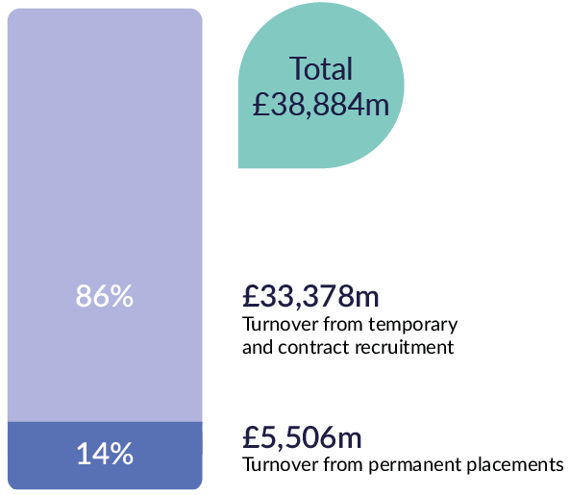
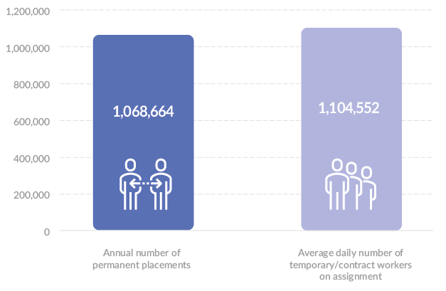
Recruitment industry trends
From Recruitment industry trends 2018/19:
The value of the UK recruitment industry was around £39 billion in 2018/19 – £5.5 billion of that was from permanent recruitment activity.
The broader industry placed over a million people into permanent jobs during 2018/19.

Slide 12
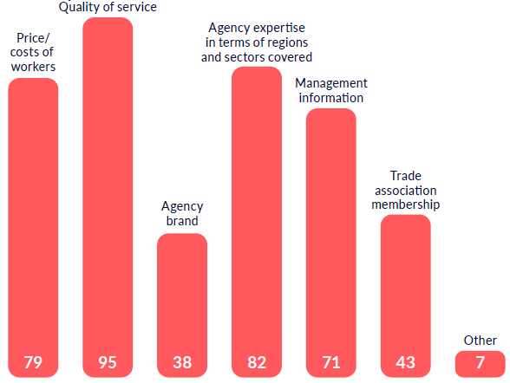
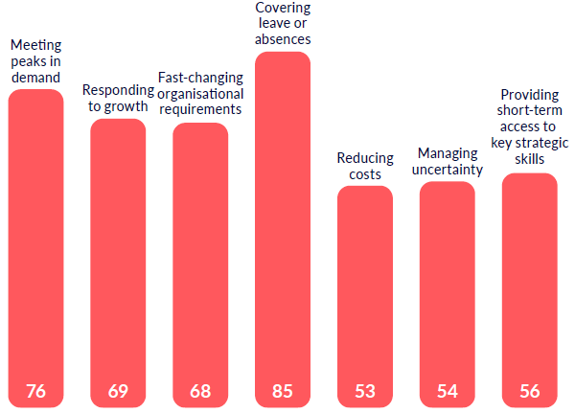
Employers value agency workers and their recruitment partners
According to our latest monthly survey of employers (JobsOutlook):
When choosing which recruiters to work with, employers increasingly value the information they provide on how to manage a temporary workforce, as well as their sectoral and local expertise
Employers feel that agency workers are increasingly valuable for responding to growth, and for managing change within their business.
Criteria used to select agencies Importance of temporary agency workers

Slide 13
RM3826
Supply Teachers
February 2020 Update

Slide 14
Framework Update
Extension and Future Improvement
Marketing and Events
Creating Effective Partnerships
Questions

Slide 15
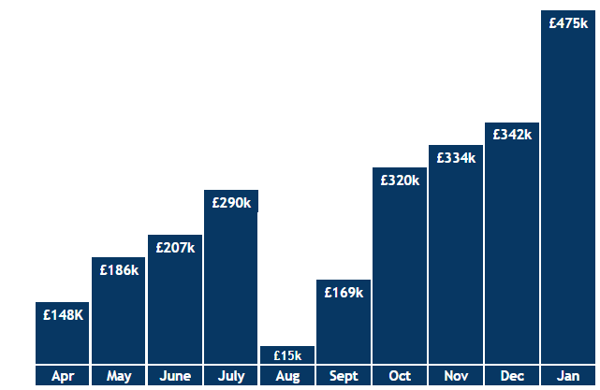
Supply Teachers
Summary
Average Mark-up
29%
Total Evidenced Spend
£3.48m
Unique Workers 2010
Suppliers 38
Total FY Spend
£2.48m
Customers 351
Total Placements
13,087
Total Spend Jan 20
£475k
FY Spend

Slide 16
Extension & Improvements
Framework extension approved for further two years; extension documentation will be sent out to framework suppliers in due course
We offer regular framework supplier meetings, with a calendar established to support future planning
Increased resource on the Supply Teachers team, with a new Strategic Lead to begin on 23rd March
Dedicated team within DfE

Slide 17
Marketing & Events
We are running monthly mailers, e-shots and Social Media campaigns with different themes and guides
We encourage you to use the material we’ve produced to help explain the framework to customers
Events:
SBP Network Leaders Darlington & London
Meetings with number of MATs and Councils
Education specific conferences/events

Slide 18
Creating Effective Partnerships
CCS are hoping to work collaboratively with suppliers to strengthen framework position within the market
Lot 2 Master Vendor contracts being established by a number of customers, can you get involved in the Supply Chain?
Partnerships also being established with other stakeholders, including NASUWT, NAHT, ISBL and NGA
CCS currently working closely with other PSBOs to consider next generation Supply Teachers agreement

Slide 19
Questions?

Slide 20
Coffee Break
Notes:
Thank you for joining us today.
In the following slides I will look at:
When do the rules changes?
What organisations will the off payroll rules apply to and what organisations will they not apply to?
Who has to pass what decisions to whom, and when?
Liability – who will be liable for unpaid tax and NICs in what circumstances
Impact on employment status
Other consequences

Slide 21
Update on REC Audited and KCSIE consultation
Chris Russell
Policy Adviser, REC
Notes:
Thank you for joining us today.
In the following slides I will look at:
When do the rules changes?
What organisations will the off payroll rules apply to and what organisations will they not apply to?
Who has to pass what decisions to whom, and when?
Liability – who will be liable for unpaid tax and NICs in what circumstances
Impact on employment status
Other consequences

Slide 22
REC Audited
Key issues (as outlined by Angie)
Please ensure that you obtain candidates permission for REC to review their files
If you are on the CCS framework please ensure that you fully apply their requirements ie – manual signing and dating of documents (not electronic) and references covering two years.
Permission to work checks cannot be outsourced to a third party
Please support each other with supplying references – even if it’s just dates and confirmation that there were ‘no safeguarding issues’.
Make sure that the work-seeker is contracted with you/umbrella before you undertake work finding services.

Slide 23
REC Audited
Key issues (continued)
You must see the original DBS check and not a copy
Adult/child workforce DBS checks are still an issue –you need a DBS for the correct workforce.
If there are any convictions/cautions on a DBS you must fax/PDF it to the client
New legislation ie Key Information Document will be incorporated into REC Audited. Angie will write to all audited holders with the revised guidance notes and ask you to confirm that you have introduced this into your day to day practices.
Please type into Sli.do or email me on chris.russell@rec.uk.com with any questions and we will get back to you.
Would a training course on REC Audited and Safeguarding be of interest?

Slide 24
KCSIE Consultation
DfE consultation on Keeping Children Safe in Education 2020 opened on 25 February and closes on 21 April.
REC will be responding on changes suggested and would like your feedback.
Respond directly to DFE’s consultation online here.
Or email me on chris.russell@rec.uk.com if you’d like to give us more detailed feedback.
Once the consultation is complete and the new KCSIE is in place, we will provide a more thorough update on the changes made.

Slide 25
KCSIE Consultation
Part four: Allegations made against teachers, including supply teachers, other staff, volunteers and contractors
No changes in statutory requirements
The changes they propose are based on the engagement they’ve done with stakeholders, which identified that:
The need for schools and colleges to ensure they understand the local authority arrangements for managing allegations, including the contact details of the local authority designated officer (LADO);
The need to clarify how the procedures in Part four should be used when dealing with allegations against supply staff. This information is set out at paragraphs 326 to 329; and
How to manage allegations that do not meet the LADO threshold.
They have proposed changes to part four, which they hope clarify the above.
Added section on ‘transferable risk’ – this is related to a scenario where staff members are involved in an incident not involving children but could have an impact on their suitability to work with children.

Slide 26
KCSIE Consultation
New section on supply teachers in section 4
Schools and colleges should ensure allegations against supply teachers are dealt with properly.
“In no circumstances should a school or college decide to cease to use a supply teacher due to safeguarding concerns, without finding out the facts and liaising with the LADO to determine a suitable outcome.”
“Governing bodies and proprietors should discuss with the supply agency whether it is appropriate to suspend the supply teacher, or redeploy them to another part of the school, whilst they carry out their investigation.”
School/colleges should take the lead on addressing allegations but “Agencies should be fully involved and co-operate with any enquiries from the LADO, police and/or children’s social services.”
“When using a supply agency, schools and colleges should inform the agency of its process for managing allegations. This should include inviting the agency’s human resource manager or equivalent to meetings and keeping them up to date with information about its policies.”

Slide 27
KCSIE Consultation
Poll Question
Are the new provisions in KCSIE on supply teachers?
Very helpful – provides clarity on previously unclear situation
Helpful - a step in right direction but more clarity needed
Unhelpful - makes things worse/less clear

Slide 28
KCSIE Consultation
Safer Recruitment
Current safer recruitment provisions don’t have enough emphasis on encouraging schools/colleges to have in place an ongoing culture of vigilance.
Proposals to restructure Part 3 on safer recruitment so it’s closer to recruitment practices followed by most employers.
“Guidance includes the processes that should be in place to achieve a safer culture for children, beginning with the wording of the vacancy advert, right through to appointment.”
They want to encourage schools to broaden the information they draw on to ensure unsuitable people don’t work with children.
No changes in statutory requirements
“Whilst some schools and colleges use HR/personnel services, it is important service providers understand the safer recruitment principles included in the draft guidance and that recruitment processes they use adopt these.”

Slide 29
KCSIE Consultation
Other Changes
For some staff there will be a shortened version of KCSIE if they don’t have regular contact with children (e.g. cleaners, kitchen staff, etc.). It’s up to the governing body to decide which version to use with these staff.
Mental health more embedded in existing safeguarding and promoting mental health is a responsibility for the whole school
Additional content on criminal exploitation and serious violence
Drafting changes to Part One and Annex B
More prominence given to online safety
More support for designated safeguarding leads
Making changes and strengthening Part 5 on sexual violence and sexual harassment
Call for evidence on how many safeguarding leads have had training in that role, how low level concerns are currently being reported and on vulnerability of international students

Slide 30
KCSIE Consultation
Poll Question
Overall, the changes to KCSIE are…
Very welcome – provides clarity on previously unclear situation
Welcome – some good proposals but more changes needed
Unwelcome – these changes make things more challenging
N/A – need more information
If you have specific areas of concern, would like to feed into REC submission, or have any questions, please get on touch on chris.russell@rec.uk.com

Slide 31
Legal Update for Education
Bunmi Adefuye, Senior Solicitor
Jane O’Shea, Solicitor
4th March 2020

Slide 32
Government’s Good Work Plan -
The Matthew Taylor Review
Government wants to embrace change in employment practices and recognises the strength of the UK’s flexible workforce.
Matthew Taylor, (now Interim Director of Labour Market Enforcement), conducted the Taylor Review of Modern Working Practices in 2017. It looked at how the government can adapt to support modern working practices like temporary labour supply, demands for additional employment rights etc.
The review was critical of “one-sided flexibility” in the labour market, stating that too much business risk is commonly transferred to recruitment businesses or gig economy workers.
In 2018 the government accepted 51 of 53 recommendations. A few are already in legal force, more will come into force in 2020.

Slide 33
Government’s response to the Taylor Review
The government’s response was published in the Good Work Plan. Today we will look at:
Repeal of the Swedish Derogation/ Pay between assignments contract
Changes to written statements of particulars
Changes to holiday pay reference period
A couple of reminders plus some proposals
The new Key Information Document

Slide 34
Repeal of the Swedish Derogation/ Pay between assignments contract
The Swedish derogation (SD) contract allows agency workers to waive their right to equal pay after the 12 week qualifying period and instead to be paid a minimum rate when they are not working on an assignment
From 6 April 2020 – the Agency Workers (Amendment) Regulations 2019 repeal regulations 10 and 11 of the Agency Workers Regulations 2010 i.e. from that date agency workers can no longer waive their right to equal pay. NB – this does not automatically terminate SD contracts (see later slide).
By no later than 30 April 2020 - an agency worker who is still on a SD contract must receive a written statement from their temporary work agency confirming they are entitled to equal pay from 6 April 2020 onwards.
If the temporary work agency does not comply, the agency worker can bring a claim to an employment tribunal for compensation
Notes:
Declaration in the contract to waive right to equal pay will no longer be applicable.
Agency workers should not be unfairly dismissed or subjected to a detriment if they:
Bring a claim under the Regulations
Give evidence in proceedings brought by another agency worker
Take action or allege that EB/TWA has breached Regulation 13A
Refuse to forgo right under the Regulations

Slide 35
Repeal of the Swedish Derogation/ Pay between assignments contract
Repeal of regulations 10 & 11 AWR does not automatically terminate the agency workers’ employment contracts so businesses need to decide whether to keep workers on these contracts, terminate or vary these contracts.
NB - check if any umbrella companies you work with use the SD contract and how they plan to manage this change.
Impact on charges to clients? Need to ensure uplift to cover equal pay.
Agency workers will have a right to not be unfairly dismissed or subjected to a detriment because of the repeal of SD contracts. This applies even if the employee has less than two years’ service.
The Department for Business, Energy and Industrial Strategy (BEIS) has amended their AWR guidance to reflect the repeal of regulations 10 & 11.
Notes:
Declaration in the contract to waive right to equal pay will no longer be applicable.
Agency workers should not be unfairly dismissed or subjected to a detriment if they:
Bring a claim under the Regulations
Give evidence in proceedings brought by another agency worker
Take action or allege that EB/TWA has breached Regulation 13A
Refuse to forgo right under the Regulations

Slide 36

Repeal of the Swedish Derogation/ Pay between assignments contract
The REC has:
removed the SD contracts from the legal resources website (now request only)
created a factsheet that explains the key issues to consider before:
terminating or amending a SD contract, or
transferring agency workers to another contract, or
retaining the contract after 6 April 2020
Notes:
Declaration in the contract to waive right to equal pay will no longer be applicable.
Agency workers should not be unfairly dismissed or subjected to a detriment if they:
Bring a claim under the Regulations
Give evidence in proceedings brought by another agency worker
Take action or allege that EB/TWA has breached Regulation 13A
Refuse to forgo right under the Regulations

Slide 37
Written statement of particulars
From 6 April 2020 there are a number of changes to the requirements around written statements of particulars:
Who must receive a written statement
When they must receive the written statement
What the written statement must contain
Notes:
Explanatory note accompanying the regulations - “it is for the employment tribunal to decide in each case, taking into account factors it considers relevant, including the circumstances of the case and the employer’s”
It also sets out factors that tribunals should consider, including, the size of the employer, the duration of the breach of the employment right and the behavior of both the employer and the employee - was breach deliberate / malice / resources etc.

Slide 38
Written statement of particulars - who and when?
From 6 April 2020
The right to receive a written statement of employment particulars will be extended from employees to all workers (Note 1). (NB - agency PAYE only (not PSCs) – umbrellas will have to manage their own workers).
This is separate to Conduct Regs requirements to agree terms with work-seeker – the ERA requires more information than the Conduct Regulations and timings for when the documents must be issued also differ.
The written statement must be given on day one of employment (Note 2).
Specific information to include (see table next slide - new information in bold) (Note 2)
Note 1: the Employment Rights Act 1996 (ERA) amended by the Employment Rights (Miscellaneous Amendments) Regulations 2019
Note 2: The Employment Rights (Employment Particulars and Paid Annual Leave) (Amendment) Regulations 2019 amend the Employment Rights Act 1996 (ERA)
Notes:
Explanatory note accompanying the regulations - “it is for the employment tribunal to decide in each case, taking into account factors it considers relevant, including the circumstances of the case and the employer’s”
It also sets out factors that tribunals should consider, including, the size of the employer, the duration of the breach of the employment right and the behavior of both the employer and the employee - was breach deliberate / malice / resources etc.

Slide 39
Written statement of particulars – what and why?
Information to provide to the worker | Written statement (ERA) | Conduct Regs
Name of employer and worker | y | y
Date employment began | y | y
Job title or description of duties | y | y
Days and hours workers are required to work, also if they are variable | y | y but not if variable
Place of work | y | y
Duration of the contract | y | y
Notice periods | y | If applicable
All remuneration, not just pay and intervals | y | y but not all renumeration
Holiday pay | y | y
Entitlement to sick leave and pay | y | n
Other entitlements such as maternity/paternity leave and other paid leave | y | n
Training entitlements (including if any is compulsory) | y | n
Duration and conditions of any probationary period | y | n
Any other benefits | y | n
Pensions and pensions schemes | y | n
Any collective agreements | y | n
Any information on disciplinary rules and grievance procedures | y | n
Requirements of:
1. Employment Rights Act 1996
&
2. Conduct of Employment Agencies and Employment Businesses Regulations 2003

Slide 40
Holiday pay reference period
From 6 April 2020
Holiday pay reference period for calculating holiday pay extended from 12 to 52 weeks.
A new cap of 104 weeks on how far the reference period can go back.
The reference period applies to workers whose pay varies because
they do not have normal working hours, or
they have normal working hours but the amount of work or days or times they work typically changes every week
If a worker has not yet worked for 52 weeks, the reference period is the total number of weeks for which the worker has worked.
BEIS will publish guidance shortly.
NB – this doesn’t change the holiday entitlement or the 12.07% calculation (it changes the reference period only).
Note 3: Regulation 16 of the Working Time Regulations 1998 amended by the Employment Rights (Employment Particulars and Paid Annual Leave) (Amendment) Regulations 2018
Notes:
Government is preparing useful guidance which will include a step by step illustration for holiday pay calculations together with a summary of cases.

Slide 41
Reminder: Itemised Payslips
Since 6 April 2019
all workers (not just employees) are entitled to receive an itemised pay slip to help workers identify whether they have been paid the correct amount.
Employers (including recruiters with temporary workers) must itemise the hours worked where the pay the worker receives varies according to the time worked.
A “day rate” worker - details must be broken down to separate figures for different types of work or different rates of pay and it must be clear which pay period they were worked in.
For more information please see the government’s guidance on additional information on payslips and the REC’s Legal bitesize (Feb 2019)

Slide 42
Reminder: Increase in financial penalties
Since 6 April 2019
The Employment Tribunals Act 1996 was amended to increase the maximum financial penalty available for an aggravated breach of a worker’s employment rights from £5,000 to £20,000.
Government’s intention is that increased penalty will deter employers from breaching employment law (Note 1).
Note 1: The Employment Rights (Miscellaneous Amendments) Regulations 2019
Notes:
Explanatory note accompanying the regulations - “it is for the employment tribunal to decide in each case, taking into account factors it considers relevant, including the circumstances of the case and the employer’s”
It also sets out factors that tribunals should consider, including, the size of the employer, the duration of the breach of the employment right and the behavior of both the employer and the employee - was breach deliberate / malice / resources etc.

Slide 43
Government’s Good Work Plan – other proposals
Other proposals to amend employment law include – no date yet confirmed:
Employment status - Government said it will “bring forward legislation” that will clarify employment status together with proposals that will align tax and employment rights.
Holiday pay – as well as increasing the pay reference period to 52 weeks, the government will also launch a holiday pay awareness campaign. See the government’s guidance on calculating holiday pay for workers without fixed hours or pay.
Agency workers who have worked with a hirer for 26 weeks will have the right to request a more predictable and stable contract from the hirer.
Government has agreed to extend the Employment Agencies Standards Inspectorate’s (EASI) remit of cover to include regulating umbrella companies in the supply chain.

Slide 44
Other possible changes (no legislation yet)
The European Parliament adopted the EU Directive on transparent and predictable working conditions in April 2019.
EU member states have three years after the date of entry to implement the Directive.
The UK remains bound by EU law until the leave date. After the leave date, government can decide whether or not to replace, amend or repeal legislation.
A number of the provisions in the Directive are already covered in the Conduct Regulations and the Good Work Plan.
Plus the right to compensation for shift cancellations and free mandatory training for workers (REC has responded to consultation on this).

Slide 45
Key Information Document
In force for all new assignments/new candidates placed on or after 6 April 2020
New regulation 13A of the Conduct Regulations will require employment businesses to give work seekers and candidates a ‘key information document’ before terms are in place with the work-seeker. It must be a separate document to the terms. (Note 1)
Why? To address the lack of transparency around who is responsible for paying candidates and the actual amount they receive particularly now that supply chains are more complex.
Content? Two parts:
General information - differs depending on who the employment business’s work seeker is e.g. PAYE worker, umbrella worker, personal services company
Plus a representative statement.
Note 1: introduced by The Conduct of Employment Agencies and Employment Businesses (Amendment) Regulations 2019

Slide 46
Key Information Document
Regulation 13A states:
The work-seeker/ candidate cannot opt out of Regulation 13A even if they opt out of the Conduct of Employment Agencies and Employment Businesses Regulations 2003.
The information must be provided in a clear and succinct manner – i.e. no more than two sides of A4 paper with 210 by 297 millimetres dimensions.
The document may contain details set out in Conduct Regulations 14 & 15 but no other additional information.
The employment business must keep records of the information.
BEIS guidance and 3 templates (one each for PAYE, PSC and umbrella)
NB – these changes do not apply in Northern Ireland or in the GLAA sector.
Notes:
Obligations around KID and PSC’s are different as the PSC is defined as the work seeker and is controlled by the person to be supplied – so only one KID must be issued – unlike an umbrella company (where both the worker and the UC get a KID)
EB’s will have to get some information from the PSC and all deductions made by either the PSC or the EB must be shown.

Slide 47
Key Information Document – PAYE (agency)
Regulation 13A(3)c - If the work seeker is the party (individual) engaged by the employment business to work for the hirer, the following information must be supplied
The title of the document at the top of the first page
A statement that identifies the purpose of the document in relation to relationship between the employment business and the work seeker
If relevant , where other related information can be found
The contact details of the Employment Agencies Standards Inspectorate(EASI)
The type of contract the work seeker will be engaged on
The identity of the employment business or who is responsible for paying the work seeker
The rate of pay or the minimum rate of pay that they can expect, to achieve for the work seeker
Intervals at which they will be paid
The amount and nature of costs and deductions from their pay
The amount and nature of fees for goods and services for which the work seeker must pay a fee
Non-monetary benefits the work seeker is entitled to receive
Annual leave entitlements and holiday pay
A representative statement that illustrates the remuneration the agency worker can expect to receive
Notes:
PAYE
Rate of pay – can be exact amount or ‘not less than MW’
Deductions:
statutory – list clearly describing all deductions – exact amounts not necessary
non-statutory – must say amount or else describe the calculation used e.g. private healthcare
fees for goods and services – must say amount or else describe the method of calculation and if one off, e.g. DBS
Other benefits
e.g. gym, amount not necessary

Slide 48
Key Information Document C - PSC
Where workers engage via their own PSC the requirements of Regulation 13A(3)(c) will apply (as set out on the previous slide for PAYE workers).
It is not possible to opt out of the requirements in Regulation 13A even if the work seeker and the limited company opt out of the Conduct Regulations.
As the PSC and the individual are both the work-seeker you just need to give one KID.
Some of the information will have to be obtained from the PSC.
The KID must show any deductions made by the employment business and the PSC so that the work seeker has a clear idea of what to expect in their pay (impact of inside versus outside IR35 engagements?).
Notes:
Obligations around KID and PSC’s are different as the PSC is defined as the work seeker and is controlled by the person to be supplied – so only one KID must be issued – unlike an umbrella company (where both the worker and the UC get a KID)
EB’s will have to get some information from the PSC and all deductions made by either the PSC or the EB must be shown.

Slide 49
Key Information Document B– umbrella company
Regulation 13A (6) - Individuals who work via an employment intermediary e.g. umbrella (not personal services company)
If the work seeker is a company or another entity, the employment business must give the information below together with the information on the previous slide to both the individual and the company:
identity of the work seeker
identity of the employer
If the employment business isn’t the employer, the identity of the person who will pay the worker
if the employment business, the work seeker, the employer and person responsible for paying the worker are connected, the nature of the connection between the parties
explanation of the difference in remuneration or minimum rate of remuneration between the work seeker who is the company and the individual carrying out the work including deductions.
Notes:
Umbrella
ROP – exact or not less than MW
Stat. deductions – exact amounts not required, list will suffice
Non-stat. deductions – must show amount to be deducted or else method of calculation

Slide 50
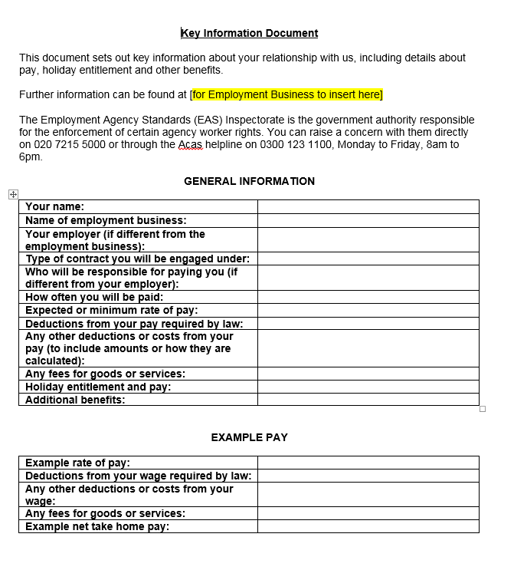
Key Information Document A – PAYE (agency)
BEIS template A
Notes:
Example pay – real numbers (can be estimated) must be used here to demonstrate how the deductions work –in a realistic way

Slide 51
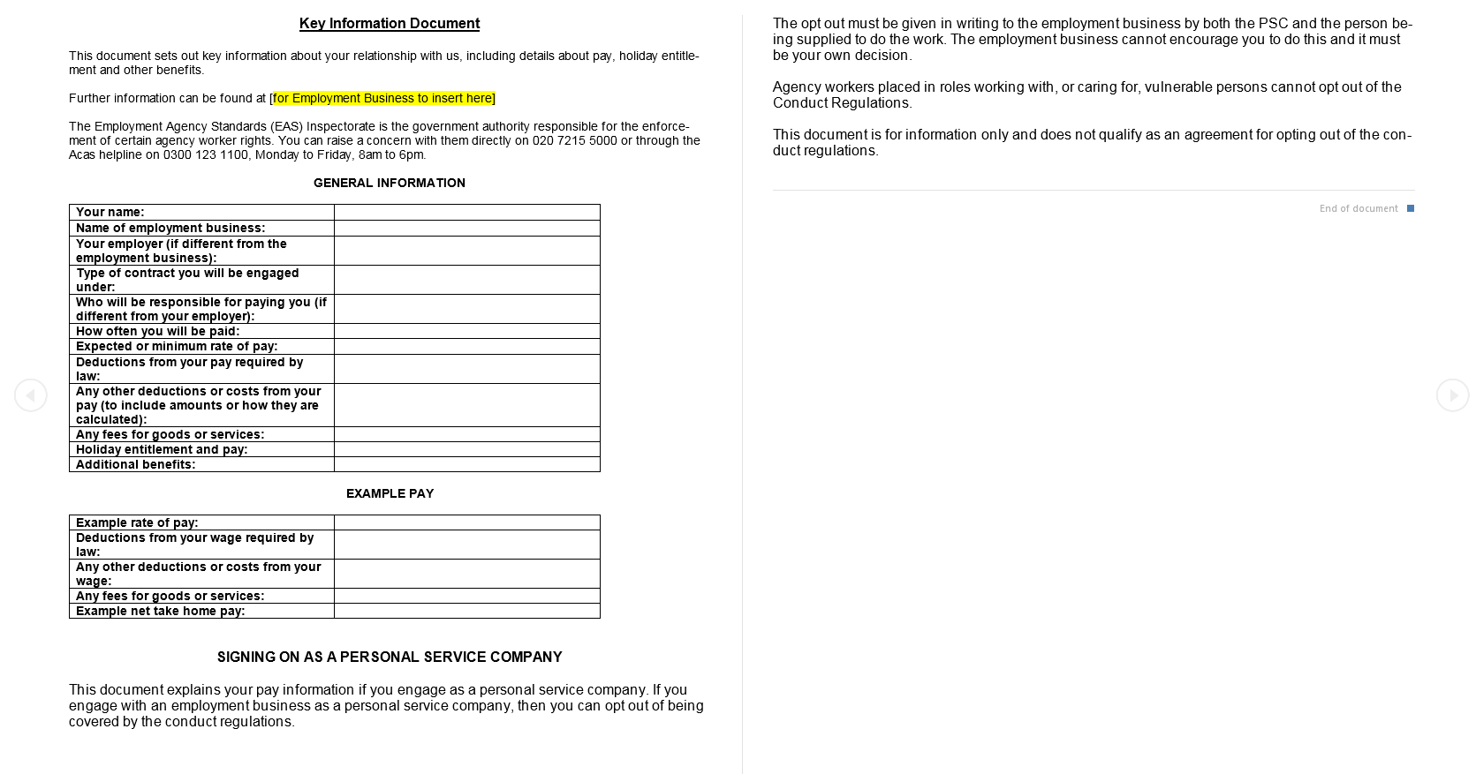
Key Information Document C- PSC
BEIS template C
Notes:
Should there be another slide on PSC KID??

Slide 52
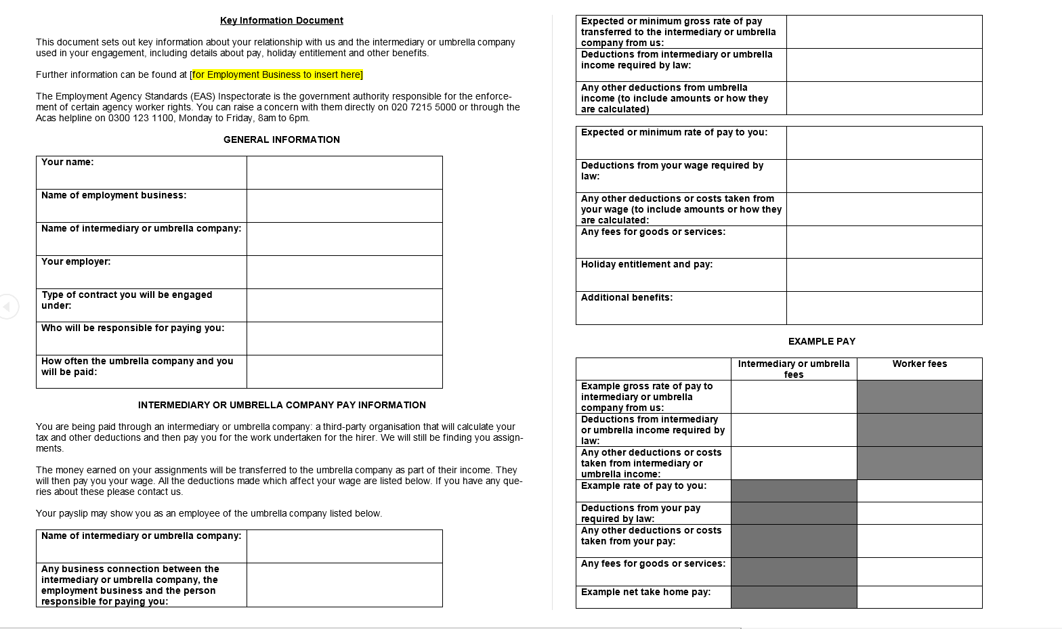
Key Information Document B- Umbrella

Slide 53
Key Information Document - Q&A on REC’s legal guide
What is the Key Information Document?
What information needs to be in it?
When does it have to be issued and to whom?
Can people opt out of regulation 13A?
How can I prepare for regulation 13A to come into force?
Do I have to give multiple Key Information Documents?
A candidate already works with an umbrella that they’re going to work through, do we still have to issue a Key Information Document?
Is there a template I can use?
Other common questions from members – Timing, payment/engagement options, if worker doesn’t know how they want to be engaged, REC templates.
Notes:
What to do now –
engage with UC’s to make sure that they have processes in place to gather the necessary information and pass it on in order to comply with obligations
determine the best processes to gather / store the information so it can be accessed easily and on time

Slide 54
We are the REC
The REC is all about brilliant recruitment, which drives our economy and delivers opportunity to millions.
As the voice of the recruitment industry, we champion high standards, speak up for great recruiters, and help them grow.
Recruitment is a powerful tool for companies and candidates to build better futures for themselves and a strong economy for the UK.
Find out more about the Recruitment & Employment Confederation at www.rec.uk.com.

Slide 55
Thank you

